Slide 1

Scientific Data Acquisition on a Raspberry Pi
06/09/2016
Ben Seeley

Slide 2
Outline
What is the existing data acquisition solution at Diamond?
Can this solution be reasonably implemented on a Raspberry Pi?
  If yes, what steps need to be taken to do so?
Can we extend the solution to more thoroughly utilise the unique opportunities presented by the Raspberry Pi’s hardware and software capabilities?

Slide 3

GDA: Diamond’s Current Data Acquisition Solution
Generic Data Acquisition (GDA) is a suite of software which allows Diamond Users and Staff to control every aspect of a beamline’s operation including:
  Manipulating samples
  Controlling the beam
  Acquiring data from scans
It provides Users with access to a scripting interface which allows long, complex experiments to be automated allowing scientists to maximise their very limited beam time.

Slide 4
Context
Phase 1 Beamlines costed between £7 and £10 million and took a total of 25 man years of effort to realise. Each!
A Raspberry Pi costs about £25 and all in the total hardware cost of the project was less than £100.
A Raspberry Pi has a 1.2 GHz processor designed for use in mobile phones.
Beamline Servers cost around £2500 and are designed for high performance computing.
Notes:
Why would you want to try and run GDA on a raspberry pi at all? Well:
To throw some numbers at you for a moment

Slide 5
Can GDA be implemented on a Raspberry Pi?
YES
*
Notes:
Yes – mostly…

Slide 6
Can GDA be implemented on a Raspberry Pi?
GDA is based on Java which is largely platform independent
GDA uses some code which is only available as pre-compiled binary files.
  These are hardware dependant and so would not work on a Pi. The question is are these sections crucial to run GDA?
It has never been tested on any hardware which isn’t high performance.
Notes:
In languages like C, a program is compiled into a binary file which is a long string of 1’s and 0’s that control the computer down to the level of the individual transistors. This makes these programs very fast, but restricted in terms of hardware that can run them. Java however takes a different strategy and instead of binary file, is compiled into Java byte code which is like a binary file, however is run on the java virtual machine which is effectively a simulation of a computer. This simulation is identical on all sorts of different hardware and the virtual machine will interpret and run those commands in the same way across any device which has a JVM available.
However there are a couple of potential issues. Firstly,

Slide 7
Equinox, Eclipse and the Standard Widget Toolkit
The software development teams use Eclipse to develop GDA for numerous reasons. But one of the big ones is that Eclipse contains a very versatile system for creating interfaces called Equinox which in turn is based on the Standard Widget Toolkit (SWT)
The problem with SWT is that it is one of the systems that is provided as a pre-compiled binary which doesn’t run on a Pi.
This problem is compounded by the fact that the GDA server relies on an Equinox Based launcher to start up correctly.
Notes:
This problem can be solved by looking at what the Equinox server does and recreating as much as possible through non-equinox alternatives.

Slide 8
Outline
What is the existing data acquisition solution at Diamond?
  It’s GDA
Can this solution be reasonably implemented on a Raspberry Pi?
  Yes!
Can we extend the solution to more thoroughly utilise the unique opportunities presented by the Raspberry Pi’s hardware and software capabilities?
Notes:
Just to return to our initial outline;

Slide 9
Extending the Raspberry Pi
What features present on the Pi are most useful?
How can we interface those features with GDA in a way that is useful?
Can we also implement some of the more complex interfaces available to control more powerful devices such as Arduinos and complex sensors?
Notes:
When deciding how to extend the Pi, there are a few key questions to consider, namely:
By no small margin, the most useful feature on the Pi is the General Purpose Input Output GPIO interface. It allows for programs running on the Pi to control numerous custom electronic devices directly through code running natively on the pi.
So we have GDA, a powerful solution for controlling complex devices which provides a versatile scripting interface for performing custom actions. And we have the GPIO interface, a customisable interface with limitless potential and a powerful API. Seem like a good fit and if we can create an integrated solution for the GPIO interface as well as arduinos and other stuff then that’s ideal. There’s always a few caveats though…

Slide 10
Restrictions on the GPIO interface
In order to use the GPIO pins on the Pi, the program in question has to be running with superuser (sudo) permissions.
Because the Pi is running a lot of code, it doesn’t handle operations which require a high timing precision well due to various other systems monopolising the CPU and preventing accurate timings.
The Raspberry Pi is very particular about how much voltage and current it can give out and receive and cannot drive high current devices such as motors.
Notes:
1. It’s generally regarded as bad practice to run more code than necessary with sudo permissions due to the damage it can do to your system.
2. I’m already using a deliberately lightweight operating system so there’s not a lot we can do about this other than to try and move any super time sensitive stuff away from the pi to other devices with internal clocks.
3. Again, not a lot we can do in software. This is a matter of good electrical engineering in the implementation and using other more tolerant devices.
The main issue, the permissions, can be easily overcome with the design I have in mind.

Slide 11
The Hardware Server
The key idea behind the design of the hardware server is that it can run independently of GDA
  The aim behind this decision was to ensure that the Raspberry Pi could be deployed in an existing beamline in a useful fashion.
By using networking technologies for communication, it makes the Pi consistent with the majority of detectors and other systems used on beamlines.
  It also massively improves the potential scalability of the system. Providing an option to deploy many Pi’s simultaneously.
It also avoids the issue of running all of GDA with sudo permissions.
Notes:
Talk about scannables as the standard interface for all connected devices:
Common Comms interface
individual scannables
- input or output configurations

Slide 12
Connecting Arduinos
The Hardware Server are connecting to the Arduino using a pair of GPIO pins which implement the I²C bus communication protocol.
The Arduino runs a custom program which functions in the same way as the Hardware server, interpreting input strings and converting them to high/low outputs or returning input values.
A distinct advantage of the Arduino is the availability of analogue inputs making it far more versatile for collecting input data.
Notes:
Inter-integrated circuit (I²C) bus. I²C is useful as it is a exceptionally common in all sorts of electronic devices, including Arduinos and sensor systems.
By implementing this common standard it opens up the platform to not only arduinos, but many more classes of device with minimal effort.
Another key benefit of the Arduino is a comparably tolerant power system capable of driving small motors and other high current devices.

Slide 13
Demo

Slide 14

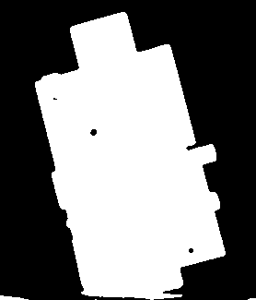

Demo

Slide 15
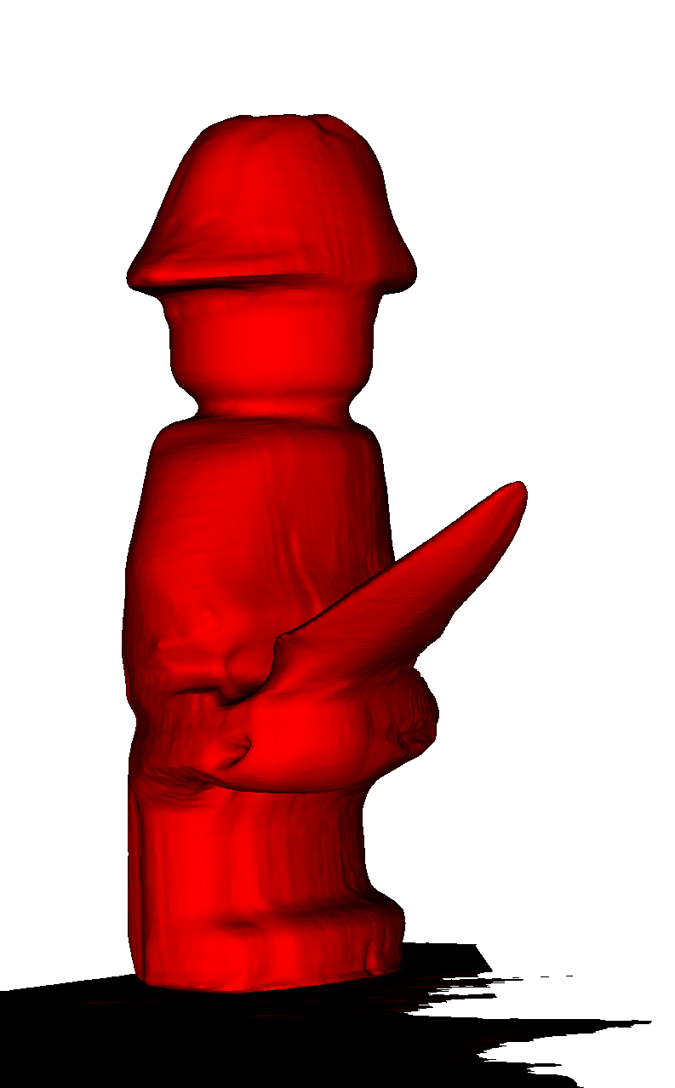
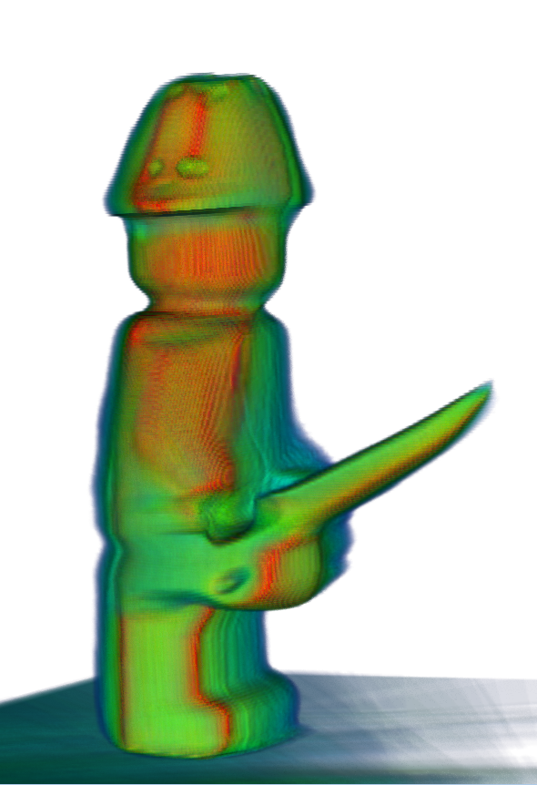
Demo

Slide 16
Further Work
The creation of a cross-compilation toolchain would allow for SWT and other elements to be recreated so they run on the Pi.
The current communication model on the i2c bus (between the Pi and Arduino’s) can support 127 devices with no modification and even more with only minimal additional hardware. It would drastically improve the system’s versatility to have a similar scalability between GDA and the hardware server on the Pi.
Implementing a Pi as a scannable device in an active beamline to see how well it performs in a real use case.

Slide 17
Acknowledgements
James Mudd
Colin Palmer
Mark Basham
Matthew Webber
All of the DAQ and SciSoft team
The Diamond Summer Students

Slide 18
How to get GDA on your Pi
Starting with an empty installation of the latest Raspbian Lite OS enter:
“curl -s –L opengda.org/getRpiServer | bash”
And in Raspi-config, enable i2c and the PiCamera

